Slide 1

TERNSHIP 2024
SAJAL SINGHAL

Slide 2
Customer Support Portal
It is an internal tool/Platform that provides a single view of a customer for GSO(Global Sales Organization) and GCO(Global Customer Operation Teams) users to manage customer information, contracts, billing, and provisioning.
Vision
To reduce the manual efforts for consumers who are using this portal

Slide 3
Product Utilization Chart
Onboarding Tasks
Feature requirement
Moving the license usage graph to another column so that the graph is visible without needing to hover on it
Why it is Required?
Reduced Cognitive Load
To reduce the effort of seeing usage graph on hovering to each licenses
Quicker Data Interpretation
As all usage bar is shown directly on page quicker analysis can be done regarding usage of those licenses

Slide 4
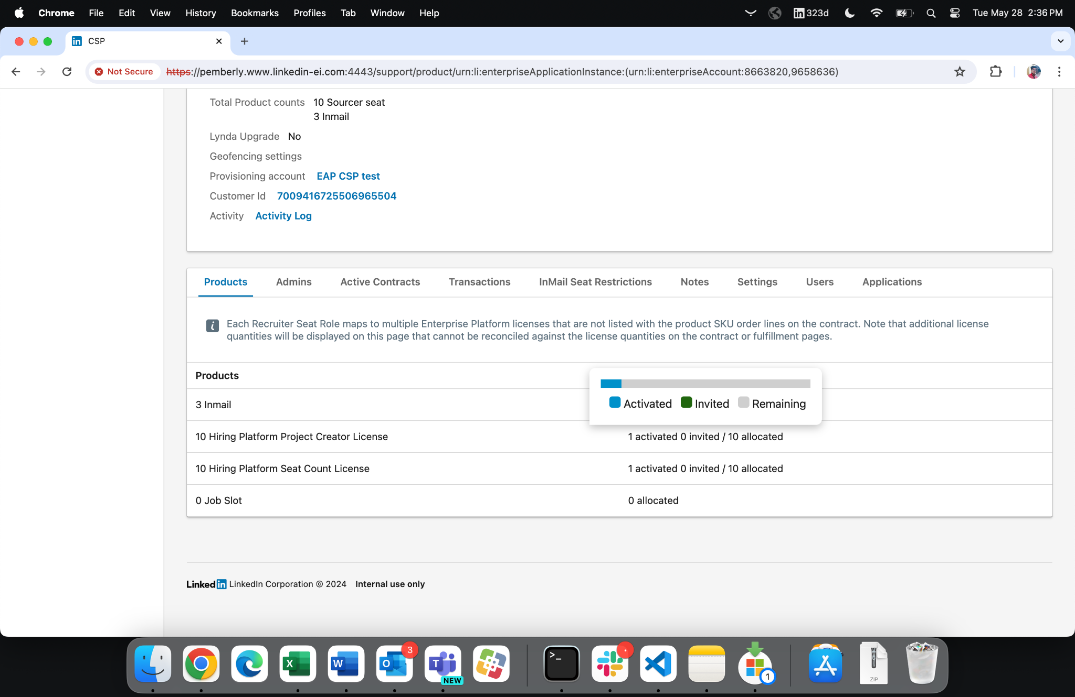
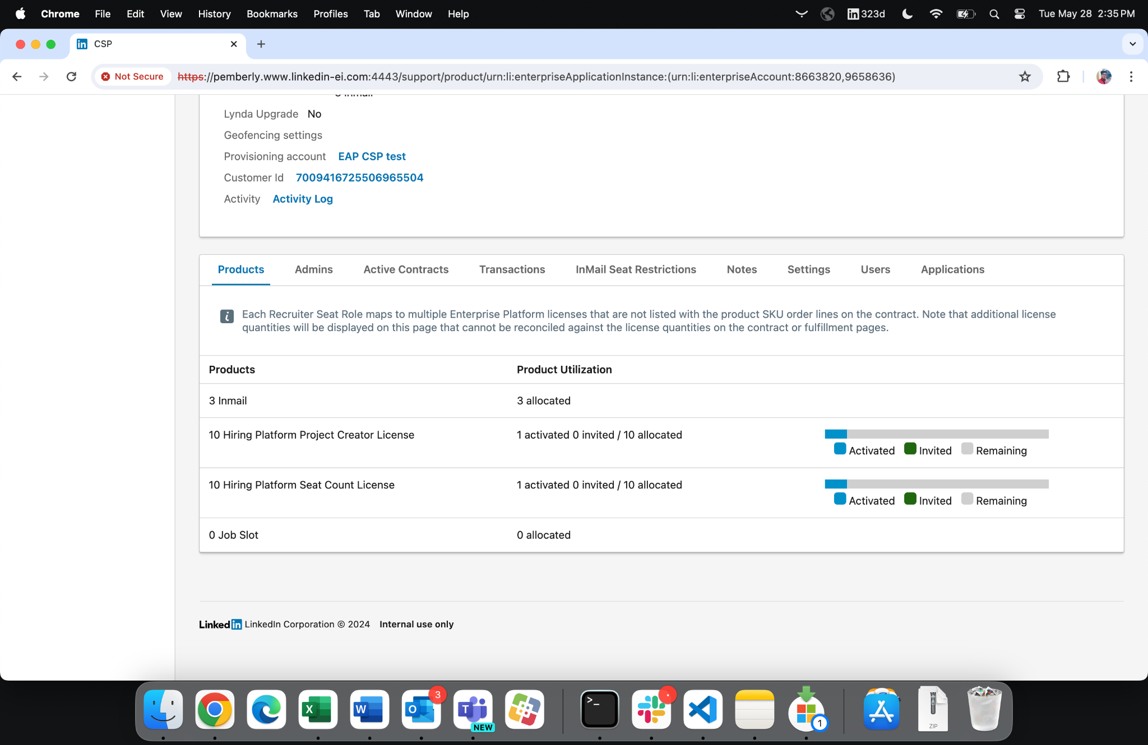
Old view
New view

Slide 5
Project - Multi-Dashboard Phase 2
Problem Statement
As highlighted in the Multi-dashboard support Recruiter PRD,
One of the most requested features is the functionality of efficient allocations to multiple dashboards in fewer clicks on CSP
We need to allocate multiple product lines (potentially across multiple years) (bundling) from a Fulfillment to multiple dashboards in a single request.
Why it is Required?
Estimated that lack of this feature resulting in an 7# clicks per line to support these provisioning requests
So our solution brought down the average number of clicks on fulfillment page to provision all item-lines by factor of 3 (for a single year Recruiter opportunity) or over 9 (for a multi-year opportunity)

Slide 6
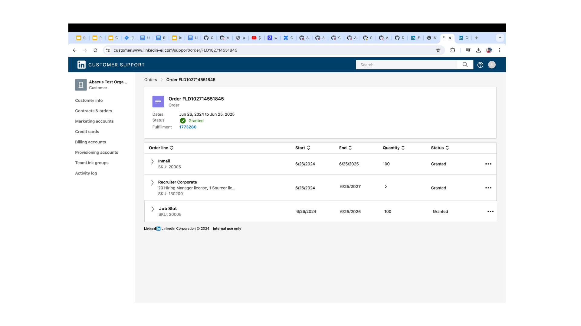
Project - Multi-Dashboard Phase 2
Order placed

Slide 7
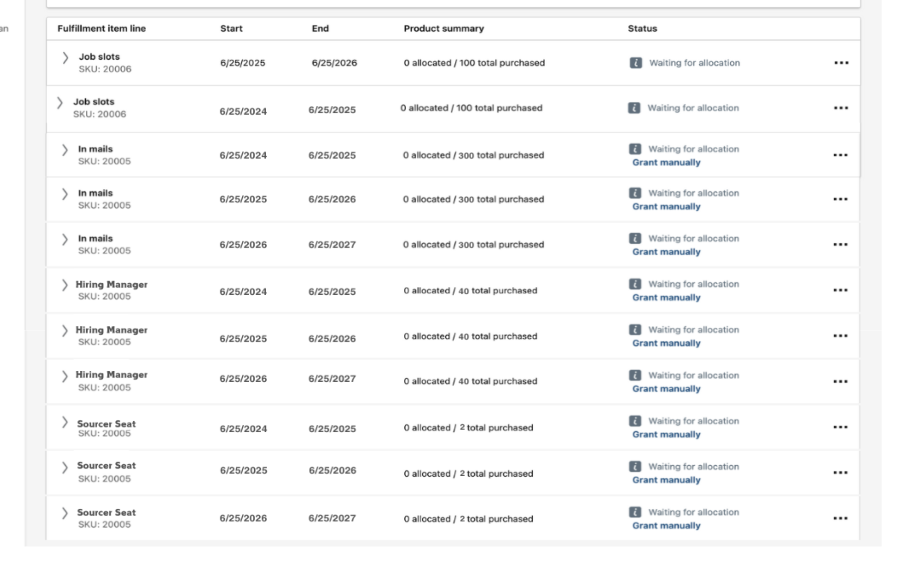
Project - Multi-Dashboard Phase 2
fulfillment page look like

Slide 8
Project - Multi-Dashboard Phase 2
Problem Statement
As highlighted in the Multi-dashboard support Recruiter PRD,
One of the most requested features is the functionality of efficient allocations to multiple dashboards in fewer clicks on CSP
We need to allocate multiple product lines (potentially across multiple years) (bundling) from a Fulfillment to multiple dashboards in a single request.
Why it is Required?
Estimated that lack of this feature resulting in an 7# clicks per line to support these provisioning requests
So our solution brought down the average number of clicks on fulfillment page to provision all item-lines by factor of 3 (for a single year Recruiter opportunity) or over 9 (for a multi-year opportunity)

Slide 9
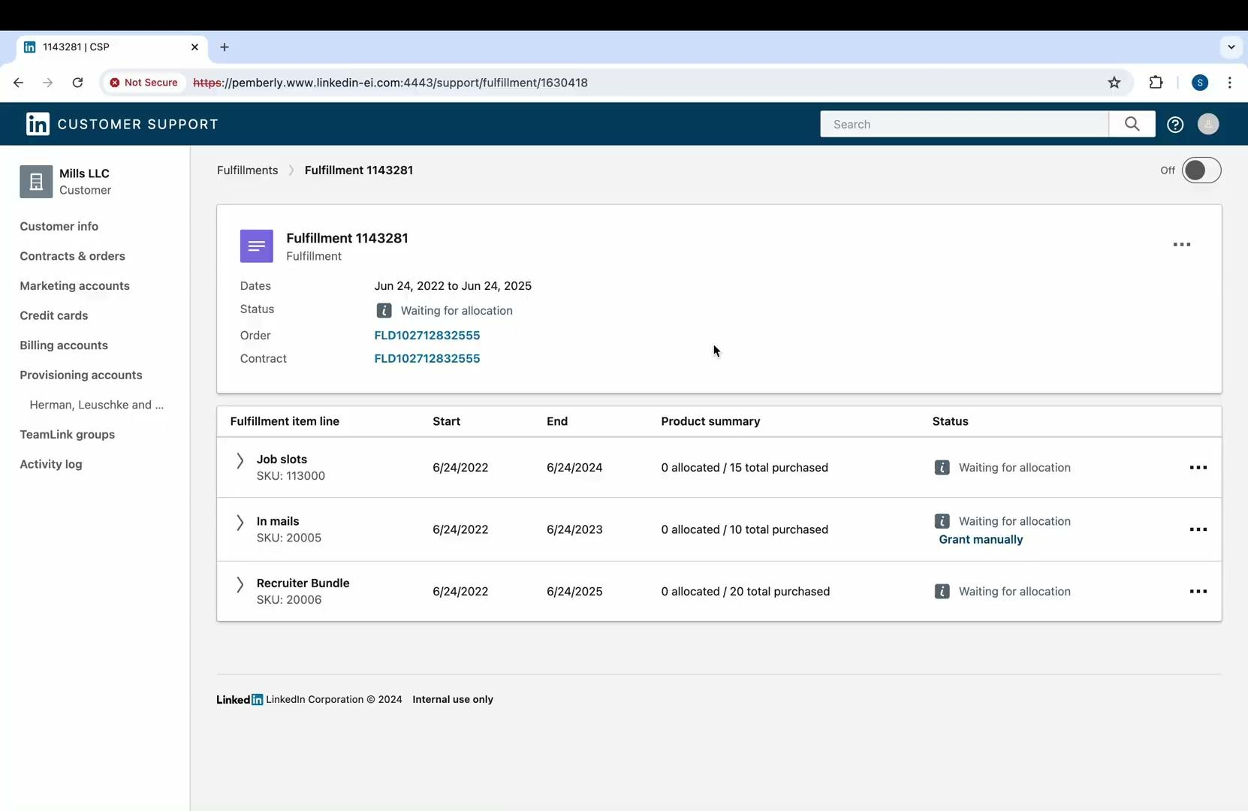
Project - Multi-Dashboard Phase 2
Solution design

Slide 10
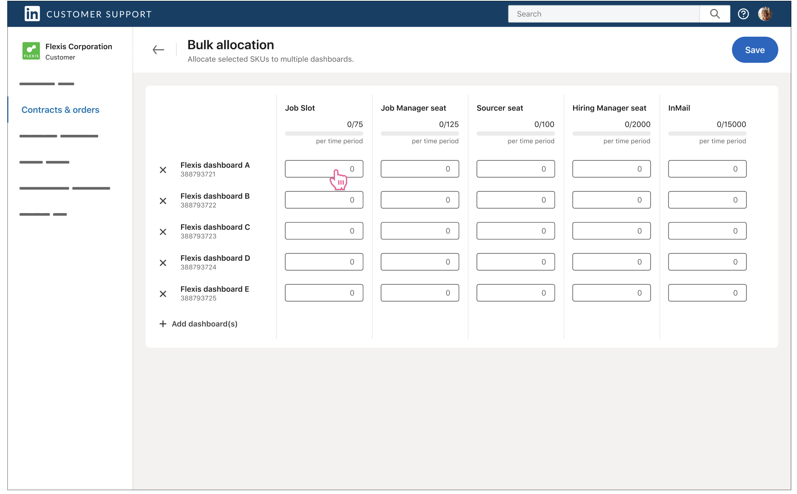
Project - Multi-Dashboard Phase 2
Future aspect

Slide 11
Project - Multi-Dashboard Phase 2
Let’s there are 2 dashboards which you want to allocate to each product lines (d = 2)
Now you have 12 number of product-lines (l = 12)
On an average you required 7# clicks per lines (c= 7)
Total number of clicks for current fulfillment page = c * l * d = 168
Select those product lines (#clicks = nl)
Go to bulk manage allocation (#clicks = 1)
Select dashboards (#clicks = 3*d) **average 3 clicks per dashboard selection
Fill the UX Grid (#clicks = nl*d)
Submit (#clicks = 1)
Calculation
Total number of clicks for new fulfillment page = nl+2+nl*d+3*d = 17

Slide 12
Project - Multi-Dashboard Phase 2
Q2 FY24 Data
Case Volume | ‘Clicks’ required | Minutes Added
26.5K cases/qtr | 6x # of lines | 15.8K minutes x # of dashboards ~ 11 days x # of dashboards

Slide 13
Project - Multi-Dashboard Phase 2
Problem Statement
As highlighted in the Multi-dashboard support Recruiter PRD,
One of the most requested features is the functionality of efficient allocations to multiple dashboards in fewer clicks on CSP
We need to allocate multiple product lines (potentially across multiple years) (bundling) from a Fulfillment to multiple dashboards in a single request.
Why it is Required?
Estimated that lack of this feature resulting in an 7# clicks per line to support these provisioning requests
So our solution brought down the average number of clicks on fulfillment page to provision all item-lines by factor of 3 (for a single year Recruiter opportunity) or over 9 (for a multi-year opportunity)

Slide 14
Challenges
Learnings
EmberJs, Rest APIs
Designing of LLD / RFC
Best practices for writing Production Level Code
Github and Git commands
Importance of Testing
Required Tools eg: lix, jira, etc..
Reasonable size PRs
Soft Skills
Attention to detail
Collaboration and Communication
Time Management
Understanding of user-experience
Exploration of component-table which can support required feature for Multi-dashboard
Multiple Iteration with Product Managers to finalise the designs of components for Multi-dashboard
Understanding the vast Codebase
Setup of MPs

Slide 15
Got Questions? Would love to discuss!

